Slide 1
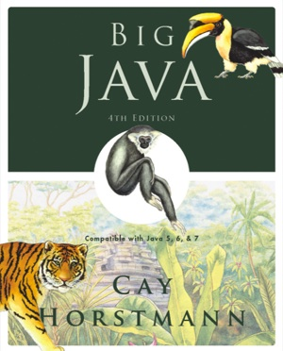
Chapter 7 – Arrays and Array Lists
Big Java by Cay Horstmann
Copyright © 2009 by John Wiley & Sons. All rights reserved.

Slide 2
Chapter Goals
To Understand about Nested Loop
To become familiar with using arrays and array lists
To learn about wrapper classes, auto-boxing and the generalized for loop
To study common array algorithms
To learn how to use two-dimensional arrays
To understand when to choose array lists and arrays in your programs
To implement partially filled arrays
Big Java by Cay Horstmann
Copyright © 2009 by John Wiley & Sons. All rights reserved.

Slide 3
Nested Loops
Create triangle shape:
[]
[][]
[][][]
[][][][]
Loop through rows:
for (int i = 1; i <= n; i++)
{
// make triangle row
}
Make triangle row is another loop:
for (int j = 1; j <= i; j++)
r = r + "[]";
r = r + "\n";
Put loops together → Nested loops
Big Java by Cay Horstmann
Copyright © 2009 by John Wiley & Sons. All rights reserved.

Slide 4
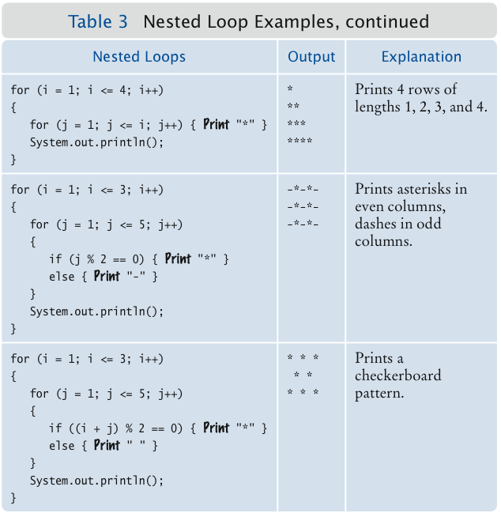
Nested Loop Examples
Big Java by Cay Horstmann
Copyright © 2009 by John Wiley & Sons. All rights reserved.

Slide 5
ch06/triangle1/Triangle.java
1 /**
2 This class describes triangle objects that can be displayed
3 as shapes like this:
4 []
5 [][]
6 [][][]
7 */
8 public class Triangle
9 {
10 private int width;
11
12 /**
13 Constructs a triangle.
14 @param aWidth the number of [] in the last row of the triangle.
15 */
16 public Triangle(int aWidth)
17 {
18 width = aWidth;
19 }
20
Continued
Big Java by Cay Horstmann
Copyright © 2009 by John Wiley & Sons. All rights reserved.

Slide 6
ch06/triangle1/Triangle.java (cont.)
21 /**
22 Computes a string representing the triangle.
23 @return a string consisting of [] and newline characters
24 */
25 public String toString()
26 {
27 String r = "";
28 for (int i = 1; i <= width; i++)
29 {
30 // Make triangle row
31 for (int j = 1; j <= i; j++)
32 r = r + "[]";
33 r = r + "\n";
34 }
35 return r;
36 }
37 }
Big Java by Cay Horstmann
Copyright © 2009 by John Wiley & Sons. All rights reserved.

Slide 7
ch06/triangle1/TriangleRunner.java
1 /**
2 This program prints two triangles.
3 */
4 public class TriangleRunner
5 {
6 public static void main(String[] args)
7 {
8 Triangle small = new Triangle(3);
9 System.out.println(small.toString());
10
11 Triangle large = new Triangle(15);
12 System.out.println(large.toString());
13 }
14 }
Continued
Big Java by Cay Horstmann
Copyright © 2009 by John Wiley & Sons. All rights reserved.

Slide 8
ch06/triangle1/TriangleRunner.java (cont.)
Program Run:
[]
[][]
[][][]
[]
[][]
[][][]
[][][][]
[][][][][]
[][][][][][]
[][][][][][][]
[][][][][][][][]
[][][][][][][][][] [][][][][][][][][][] [][][][][][][][][][][] [][][][][][][][][][][][] [][][][][][][][][][][][][]
[][][][][][][][][][][][][][] [][][][][][][][][][][][][][][]
Big Java by Cay Horstmann
Copyright © 2009 by John Wiley & Sons. All rights reserved.

Slide 9
Random Numbers and Simulations
In a simulation, you repeatedly generate random numbers and use them to simulate an activity
Random number generator
  Random generator = new Random();
  int n = generator.nextInt(a); // 0 < = n < a
  double x = generator.nextDouble(); // 0 <= x < 1
Throw die (random number between 1 and 6)
  int d = 1 + generator.nextInt(6);
Big Java by Cay Horstmann
Copyright © 2009 by John Wiley & Sons. All rights reserved.

Slide 10
ch06/random1/Die.java
1 import java.util.Random;
2
3 /**
4 This class models a die that, when cast, lands on a random
5 face.
6 */
7 public class Die
8 {
9 private Random generator;
10 private int sides;
11
12 /**
13 Constructs a die with a given number of sides.
14 @param s the number of sides, e.g. 6 for a normal die
15 */
16 public Die(int s)
17 {
18 sides = s;
19 generator = new Random();
20 }
21
Continued
Big Java by Cay Horstmann
Copyright © 2009 by John Wiley & Sons. All rights reserved.

Slide 11
ch06/random1/Die.java (cont.)
22 /**
23 Simulates a throw of the die
24 @return the face of the die
25 */
26 public int cast()
27 {
28 return 1 + generator.nextInt(sides);
29 }
30 }
Big Java by Cay Horstmann
Copyright © 2009 by John Wiley & Sons. All rights reserved.

Slide 12
ch06/random1/DieSimulator.java
1 /**
2 This program simulates casting a die ten times.
3 */
4 public class DieSimulator
5 {
6 public static void main(String[] args)
7 {
8 Die d = new Die(6);
9 final int TRIES = 10;
10 for (int i = 1; i <= TRIES; i++)
11 {
12 int n = d.cast();
13 System.out.print(n + " ");
14 }
15 System.out.println();
16 }
17 }
Continued
Big Java by Cay Horstmann
Copyright © 2009 by John Wiley & Sons. All rights reserved.

Slide 13
ch06/random1/DieSimulator.java (cont.)
Output:
6 5 6 3 2 6 3 4 4 1
Second Run:
3 2 2 1 6 5 3 4 1 2
Big Java by Cay Horstmann
Copyright © 2009 by John Wiley & Sons. All rights reserved.

Slide 14
Arrays
Array: Sequence of values of the same type
Construct array:
new double[10]
Store in variable of type double[]:
double[] data = new double[10];
When array is created, all values are initialized depending on array type:
  Numbers: 0
  Boolean: false
  Object References: null
Big Java by Cay Horstmann
Copyright © 2009 by John Wiley & Sons. All rights reserved.

Slide 15
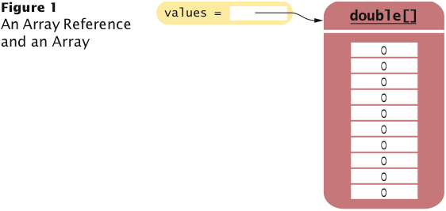
Arrays
Big Java by Cay Horstmann
Copyright © 2009 by John Wiley & Sons. All rights reserved.

Slide 16
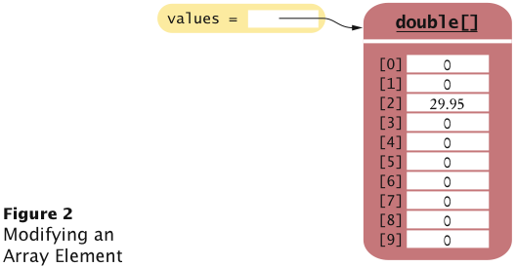
Arrays
Use [] to access an element:
  values[2] = 29.95;
Big Java by Cay Horstmann
Copyright © 2009 by John Wiley & Sons. All rights reserved.

Slide 17
Arrays
Using the value stored:
System.out.println("The value of this data item is "
+ values[2]);
Get array length as values.length (Not a method!)
Index values range from 0 to length - 1
Accessing a nonexistent element results in a bounds error:
double[] values = new double[10];
values[10] = 29.95; // ERROR
Limitation: Arrays have fixed length
Big Java by Cay Horstmann
Copyright © 2009 by John Wiley & Sons. All rights reserved.

Slide 18
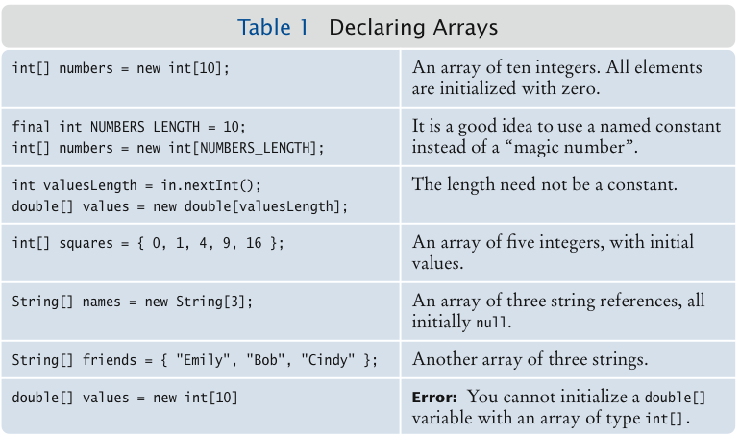
Declaring Arrays
Big Java by Cay Horstmann
Copyright © 2009 by John Wiley & Sons. All rights reserved.

Slide 19
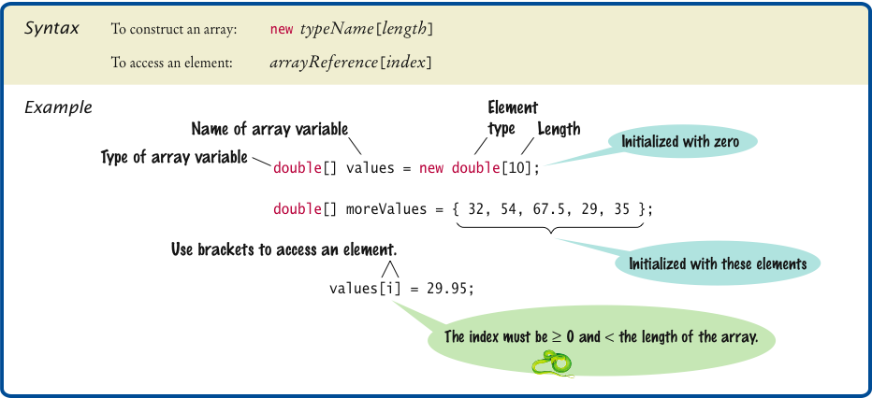
Syntax 7.1 Arrays
Big Java by Cay Horstmann
Copyright © 2009 by John Wiley & Sons. All rights reserved.

Slide 20
Self Check 7.1
What elements does the data array contain after the following statements?
  double[] values = new double[10];
  for (int i = 0; i < values.length; i++)
  values[i] = i * i;
Answer: 0, 1, 4, 9, 16, 25, 36, 49, 64, 81, but not 100

Slide 21
Self Check 7.2
What do the following program segments print? Or, if there is an error, describe the error and specify whether it is detected at compile-time or at run-time.
    double[] a = new double[10];
    System.out.println(a[0]);
    double[] b = new double[10];
    System.out.println(b[10]);
    double[] c;
    System.out.println(c[0]);
  Answer:
      0
      a run-time error: array index out of bounds
      a compile-time error: c is not initialized

Slide 22
Array Lists
ArrayList class manages a sequence of objects
Can grow and shrink as needed
ArrayList class supplies methods for many common tasks, such as inserting and removing elements
ArrayList is a generic class:
  ArrayList<T>
  collects objects of type parameter T:
  ArrayList<String> names = new ArrayList<String>();
  names.add("Emily");
  names.add("Bob");
  names.add("Cindy");
size method yields number of elements
Big Java by Cay Horstmann
Copyright © 2009 by John Wiley & Sons. All rights reserved.

Slide 23
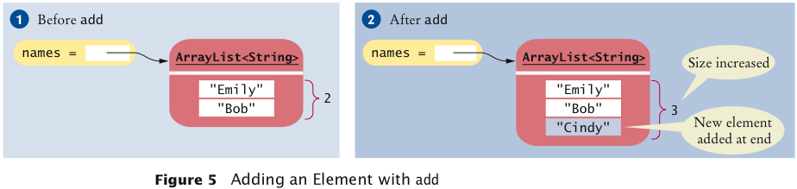
Adding Elements
To add an object to the end of the array list, use the add method:
  names.add("Emily");
  names.add("Bob");
  names.add("Cindy");
Big Java by Cay Horstmann
Copyright © 2009 by John Wiley & Sons. All rights reserved.

Slide 24
Retrieving Array List Elements
To obtain the value an element at an index, use the get method
Index starts at 0
String name = names.get(2);
// gets the third element of the array list
Bounds error if index is out of range
Most common bounds error:
  int i = names.size();
  name = names.get(i); // Error
  // legal index values are 0 ... i-1
Big Java by Cay Horstmann
Copyright © 2009 by John Wiley & Sons. All rights reserved.

Slide 25
Setting Elements
To set an element to a new value, use the set method:
  names.set(2, "Carolyn");
Big Java by Cay Horstmann
Copyright © 2009 by John Wiley & Sons. All rights reserved.

Slide 26
Removing Elements
To remove an element at an index, use the remove method:
  names.remove(1);
Big Java by Cay Horstmann
Copyright © 2009 by John Wiley & Sons. All rights reserved.

Slide 27
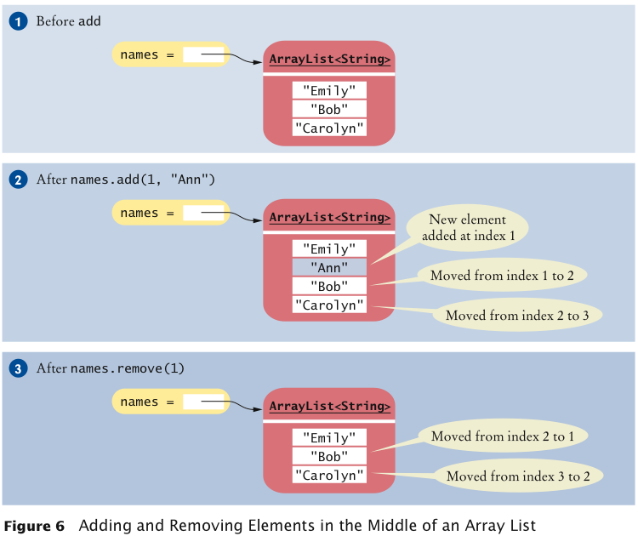
Adding and Removing Elements
  names.add("Emily");
  names.add("Bob");
  names.add("Cindy");
  names.set(2, "Carolyn");
  names.add(1, "Ann");
  names.remove(1);
Big Java by Cay Horstmann
Copyright © 2009 by John Wiley & Sons. All rights reserved.

Slide 28
Working with Array Lists
ArrayList<String> names = new ArrayList<String>(); | Constructs an empty array list that can hold strings.
names.add("Ann"); names.add("Cindy"); | Adds elements to the end.
System.out.println(names); | Prints [Ann, Cindy].
names.add(1, "Bob"); | Inserts an element at index 1. names is now [Ann, Bob, Cindy].
names.remove(0); | Removes the element at index 0. names is now [Bob, Cindy].
names.set(0, "Bill"); | Replaces an element with a different value. names is now [Bill, Cindy].
Big Java by Cay Horstmann
Copyright © 2009 by John Wiley & Sons. All rights reserved.

Slide 29
Working with Array Lists (cont.)
String name = names.get(i); | Gets an element.
String last = names.get(names.size() - 1); | Gets the last element.
ArrayList<Integer> squares = new ArrayList<Integer>(); for (int i = 0; i < 10; i++) { squares.add(i * i); } | Constructs an array list holding the first ten squares.
Big Java by Cay Horstmann
Copyright © 2009 by John Wiley & Sons. All rights reserved.

Slide 30
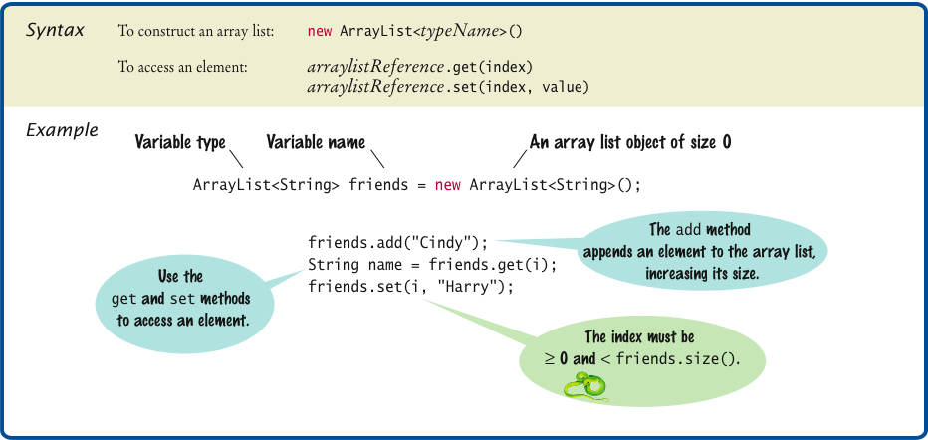
Syntax 7.2 Array Lists
Big Java by Cay Horstmann
Copyright © 2009 by John Wiley & Sons. All rights reserved.

Slide 31
Self Check 7.3
How do you construct an array of 10 strings? An array list of strings?
  Answer:
new String[10];
new ArrayList<String>();

Slide 32
Self Check 7.4
What is the content of names after the following statements?
ArrayList<String> names = new ArrayList<String>();
names.add("A");
names.add(0, "B");
names.add("C");
names.remove(1);
  Answer: names contains the strings "B" and "C" at positions 0 and 1

Slide 33
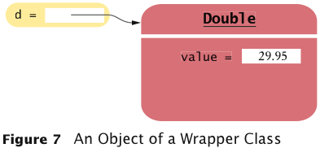
Wrapper Classes
For each primitive type there is a wrapper class for storing values of that type:
  Double d = new Double(29.95);
Wrapper objects can be used anywhere that objects are required instead of primitive type values:
  ArrayList<Double> values= new ArrayList<Double>();
  data.add(29.95);
  double x = data.get(0);
Big Java by Cay Horstmann
Copyright © 2009 by John Wiley & Sons. All rights reserved.

Slide 34
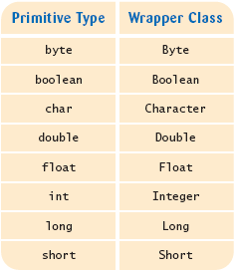
Wrappers
There are wrapper classes for all eight primitive types:
Big Java by Cay Horstmann
Copyright © 2009 by John Wiley & Sons. All rights reserved.

Slide 35
Self Check 7.6
Suppose values is an ArrayList<Double> of size > 0. How do you increment the element with index 0?
  Answer:
    values.set(0, values.get(0) + 1);

Slide 36
Common Array Algorithm: Filling
Fill an array with zeroes:
    for (int i = 0; i < values.length; i++)
    {
    values[i] = 0;
    }
Fill an array list with squares (0, 1, 4, 9, 16, ...):
    for (int i = 0; i < values.size(); i++)
    {
    values.set(i, i * i;
    }
Big Java by Cay Horstmann
Copyright © 2009 by John Wiley & Sons. All rights reserved.

Slide 37
Common Array Algorithm: Removing an Element
Array list ⇒ use method remove
Unordered array ⇒
    Overwrite the element to be removed with the last element of the array
    Decrement the variable tracking the size of the array
      values[pos] = values[valuesSize - 1];
      valuesSize--;
Big Java by Cay Horstmann
Copyright © 2009 by John Wiley & Sons. All rights reserved.

Slide 38
Common Array Algorithm: Removing an Element
Ordered array ⇒
    Move all elements following the element to be removed to a lower index
    Decrement the variable tracking the size of the array
      for (int i = pos; i < valuesSize - 1; i++)
      {
      values[i] = values[i + 1];
      }
      valuesSize--;
Big Java by Cay Horstmann
Copyright © 2009 by John Wiley & Sons. All rights reserved.

Slide 39
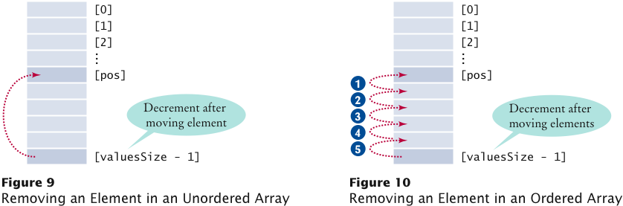
Common Array Algorithm: Removing an Element
Big Java by Cay Horstmann
Copyright © 2009 by John Wiley & Sons. All rights reserved.

Slide 40
Common Array Algorithm: Inserting an Element
Array list ⇒ use method add
Unordered array ⇒
    Insert the element as the last element of the array
    Increment the variable tracking the size of the array
      if (valuesSize < values.length)
      {
      values[valuesSize] = newElement;
      valuesSize++;
      }
Big Java by Cay Horstmann
Copyright © 2009 by John Wiley & Sons. All rights reserved.

Slide 41
Common Array Algorithm: Inserting an Element
Ordered array ⇒
    Start at the end of the array, move that element to a higher index, then move the one before that, and so on until you finally get to the insertion location
    Insert the element
    Increment the variable tracking the size of the array
      if (valuesSize < values.length)
      {
      for (int i = valuesSize; i > pos; i--)
      {
      values[i] = values[i - 1];
      }
      values[pos] = newElement;
      valuesSize++;
      }
Big Java by Cay Horstmann
Copyright © 2009 by John Wiley & Sons. All rights reserved.

Slide 42
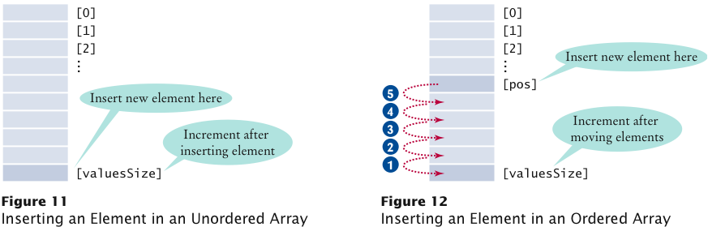
Common Array Algorithm: Inserting an Element
Big Java by Cay Horstmann
Copyright © 2009 by John Wiley & Sons. All rights reserved.

Slide 43
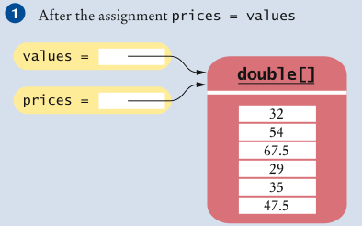
Common Array Algorithm: Copying an Array
Copying an array variable yields a second reference to the same array:
    double[] values = new double[6];
    . . . // Fill array
    double[] prices = values;
Big Java by Cay Horstmann
Copyright © 2009 by John Wiley & Sons. All rights reserved.

Slide 44
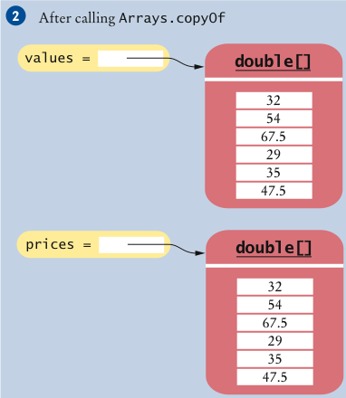
Common Array Algorithm: Copying an Array
To make a true copy of an array, call the Arrays.copyOf method:
  double[] prices = Arrays.copyOf(values, values.length);
Big Java by Cay Horstmann
Copyright © 2009 by John Wiley & Sons. All rights reserved.

Slide 45
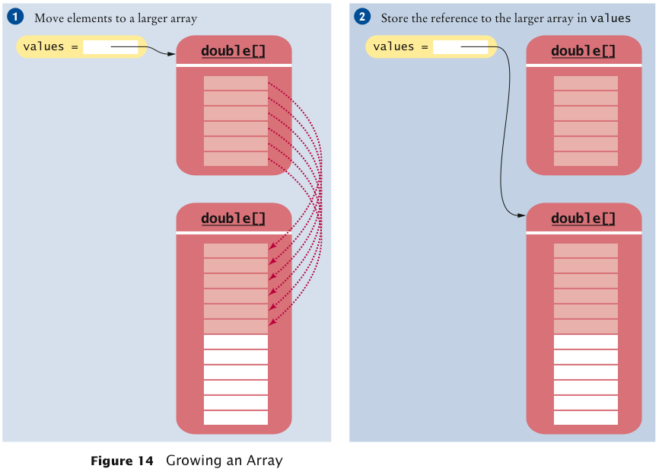
Common Array Algorithm: Copying an Array
To grow an array that has run out of space, use the Arrays.copyOf method:
    values = Arrays.copyOf(values, 2 * values.length);
Big Java by Cay Horstmann
Copyright © 2009 by John Wiley & Sons. All rights reserved.

Slide 46
Common Array Algorithm: Growing an Array
Example: Read an arbitrarily long sequence numbers into an array, without running out of space:
    int valuesSize = 0;
    while (in.hasNextDouble())
    {
    if (valuesSize == values.length)
    values = Arrays.copyOf(values, 2 * values.length);
    values[valuesSize] = in.nextDouble();
    valuesSize++;
    }
Big Java by Cay Horstmann
Copyright © 2009 by John Wiley & Sons. All rights reserved.

Slide 47
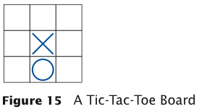
Two-Dimensional Arrays
When constructing a two-dimensional array, specify how
many rows and columns are needed:
  final int ROWS = 3;
  final int COLUMNS = 3;
  String[][] board = new String[ROWS][COLUMNS];
Access elements with an index pair:
    board[1][1] = "x";
    board[2][1] = "o";
Big Java by Cay Horstmann
Copyright © 2009 by John Wiley & Sons. All rights reserved.

Slide 48
Traversing Two-Dimensional Arrays
It is common to use two nested loops when filling or searching:
  for (int i = 0; i < ROWS; i++)
  for (int j = 0; j < COLUMNS; j++)
  board[i][j] = " ";
Big Java by Cay Horstmann
Copyright © 2009 by John Wiley & Sons. All rights reserved.

Slide 49
Traversing Two-Dimensional Arrays
You can also recover the array dimensions from the array variable:
    board.length is the number of rows
    board[0].length is the number of columns
Rewrite the loop for filling the tic-tac-toe board:
  for (int i = 0; i < board.length; i++)
  for (int j = 0; j < board[0].length; j++)
  board[i][j] = " ";
Big Java by Cay Horstmann
Copyright © 2009 by John Wiley & Sons. All rights reserved.

Slide 50
ch07/twodim/TicTacToe.java
1 /**
2 A 3 x 3 tic-tac-toe board.
3 */
4 public class TicTacToe
5 {
6 private String[][] board;
7 private static final int ROWS = 3;
8 private static final int COLUMNS = 3;
9
10 /**
11 Constructs an empty board.
12 */
13 public TicTacToe()
14 {
15 board = new String[ROWS][COLUMNS];
16 // Fill with spaces
17 for (int i = 0; i < ROWS; i++)
18 for (int j = 0; j < COLUMNS; j++)
19 board[i][j] = " ";
20 }
21
Continued
Big Java by Cay Horstmann
Copyright © 2009 by John Wiley & Sons. All rights reserved.

Slide 51
ch07/twodim/TicTacToe.java (cont.)
22 /**
23 Sets a field in the board. The field must be unoccupied.
24 @param i the row index
25 @param j the column index
26 @param player the player ("x" or "o")
27 */
28 public void set(int i, int j, String player)
29 {
30 if (board[i][j].equals(" "))
31 board[i][j] = player;
32 }
33
Continued
Big Java by Cay Horstmann
Copyright © 2009 by John Wiley & Sons. All rights reserved.

Slide 52
ch07/twodim/TicTacToe.java (cont.)
35 Creates a string representation of the board, such as
36 |x o|
37 | x |
38 | o|
39 @return the string representation
40 */
41 public String toString()
42 {
43 String r = "";
44 for (int i = 0; i < ROWS; i++)
45 {
46 r = r + "|";
47 for (int j = 0; j < COLUMNS; j++)
48 r = r + board[i][j];
49 r = r + "|\n";
50 }
51 return r;
52 }
53 }
Big Java by Cay Horstmann
Copyright © 2009 by John Wiley & Sons. All rights reserved.

Slide 53
ch07/twodim/TicTacToeRunner.java
1 import java.util.Scanner;
2
3 /**
4 This program runs a TicTacToe game. It prompts the
5 user to set positions on the board and prints out the
6 result.
7 */
8 public class TicTacToeRunner
9 {
10 public static void main(String[] args)
11 {
12 Scanner in = new Scanner(System.in);
13 String player = "x";
14 TicTacToe game = new TicTacToe();
Continued
Big Java by Cay Horstmann
Copyright © 2009 by John Wiley & Sons. All rights reserved.

Slide 54
ch07/twodim/TicTacToeRunner.java (cont.)
15 boolean done = false;
16 while (!done)
17 {
18 System.out.print(game.toString());
19 System.out.print(
20 "Row for " + player + " (-1 to exit): ");
21 int row = in.nextInt();
22 if (row < 0) done = true;
23 else
24 {
25 System.out.print("Column for " + player + ": ");
26 int column = in.nextInt();
27 game.set(row, column, player);
28 if (player.equals("x"))
29 player = "o";
30 else
31 player = "x";
32 }
33 }
34 }
35 }
Big Java by Cay Horstmann
Copyright © 2009 by John Wiley & Sons. All rights reserved.

Slide 55
ch07/twodim/TicTacToeRunner.java (cont.)
Program Run:
| |
| |
| |
Row for x (-1 to exit): 1
Column for x: 2
| |
| x |
| |
Row for o (-1 to exit): 0
Column for o: 0
|o |
| x|
| |
Row for x (-1 to exit): -1
Big Java by Cay Horstmann
Copyright © 2009 by John Wiley & Sons. All rights reserved.

Slide 56
Self Check 7.19
How do you declare and initialize a 4-by-4 array of integers?
  Answer:
  int[][] array = new int[4][4];

Slide 57
Self Check 7.20
How do you count the number of spaces in the tic-tac-toe board?
  Answer:
int count = 0;
for (int i = 0; i < ROWS; i++)
for (int j = 0; j < COLUMNS; j++)
if (board[i][j] == ' ') count++;

